Slide 1
Day 28
8.1 - OOP
PROFESSOR RAMSEY
GDC 6.318
ramsey@cs.utexas.edu

Slide 2
Announcements
Schedule
Begin Chapter 8 today.
Test Review on Wednesday.
Test Wednesday night.
See Ed Discussion for test details.

Slide 3
Rubber Duck Debugging
Beg, borrow, steal, buy, fabricate or otherwise obtain a rubber duck (bathtub variety).
Place rubber duck on desk and inform it you are just going to go over some code with it, if that’s all right.
Explain to the duck what your code is supposed to do, and then go into detail and explain your code line by line.
At some point you will tell the duck what you are doing next and then realise that that is not in fact what you are actually doing. The duck will sit there serenely, happy in the knowledge that it has helped you on your way.
from Andrew Hunt and David Thomas, The Pragmatic Programmer

Slide 4
No Quiz Today

Slide 5
8.1
Object Oriented Programming
Notes:
Session Title: Project Based Learning (PBL) for Equity in CS classes
Session Description: If you are teaching a survey course like Computer Science Principles, or a code intensive course like AP CS A, PBL can serve as a powerful tool to increase student interest and engagement. Learn about research that connects PBL to improved student outcomes, especially for girls and underrepresented minorities. Discover available PBL resources and understand PBL lesson components, so you can build your own.

Slide 6
The software crisis
software engineering: The practice of developing, designing, documenting, testing large computer programs.
Large-scale projects face many issues:
getting many programmers to work together
getting code finished on time
avoiding redundant code
finding and fixing bugs
maintaining, improving, and reusing existing code
code reuse: The practice of writing program code once and using it in many contexts.

Slide 7
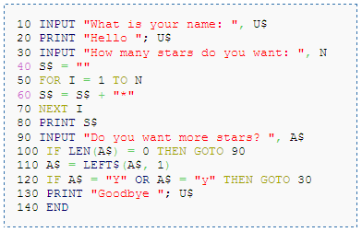
Procedural Language - BASIC
Image courtesy of https://elmcip.net/platformsoftware/basic.

Slide 8
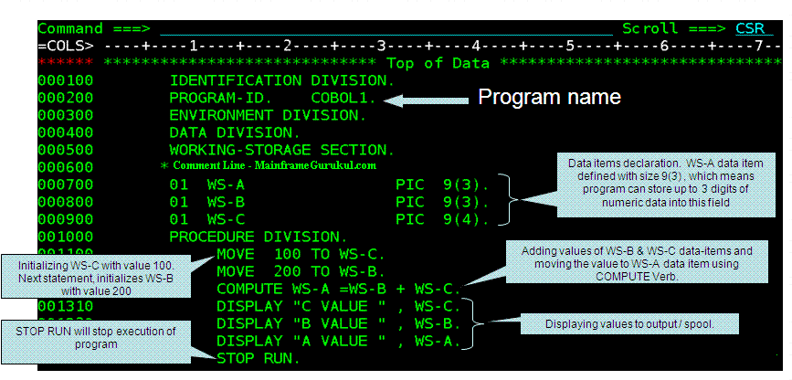
Procedural Language - COBOL
Image courtesy of mainframegurukul.com.

Slide 9
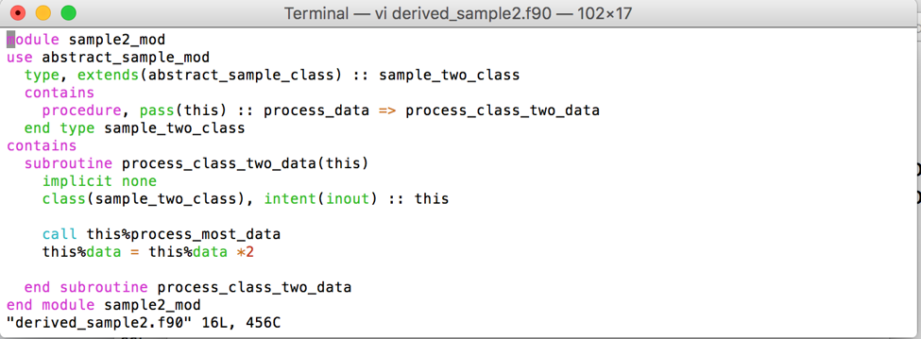
Procedural Language - Fortran
Image courtesy of https://redlineperf.com/.

Slide 10
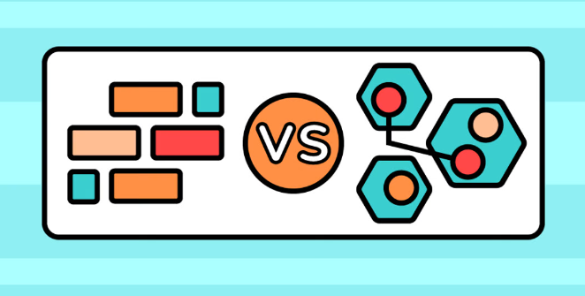
Functional and Object Oriented Programming
(Java, Python, C++)
Image courtesy of https://www.educative.io/blog/functional-programming-vs-oop.

Slide 11
Programming Paradigms
Procedural languages (BASIC, COBOL, Fortran, C)
Top-down design, more global data, limited code reuse
Used in engineering (NASA) and banking (everyone)
Functional languages (Java, C++, Python)
Program organized by pure functions without side effects
Best for theoretical problem solving
Object-Oriented languages (also Java, C++, Python)
Program organized by items with related data and methods.
Best for real-world business applications

Slide 12
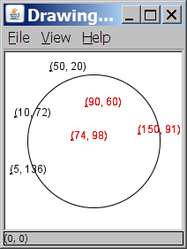
Rainfall Program
Given a file of cities' (x, y) coordinates, which begins with the number of cities:
6
50 20
90 60
10 72
74 98
5 136
150 91
Imagine a program to draw the cities on a DrawingPanel, then rain falls in some of the cities, in the shape of a perfect circle.
Center of rain x? 100
Center of rain y? 100
Rain radius? 75
Watch the flowers grow!

Slide 13
A Bad Solution
Scanner input = new Scanner(new File("cities.txt"));
int cityCount = input.nextInt();
int[] xCoords = new int[cityCount];
int[] yCoords = new int[cityCount];
for (int i = 0; i < cityCount; i++) {
xCoords[i] = input.nextInt(); // read each city
yCoords[i] = input.nextInt();
}
...
parallel arrays: 2+ arrays with related data at same indexes.
Considered poor style. What if you wanted to also track city name, population, mayor, etc? How many parallel arrays?

Slide 14
Observations
It would be better to consider a city one “thing” and give it one name.
Each city could have its own behaviors/methods, like draw() to place it on a DrawingPanel.
If we combine this idea with an array, can store a lot of data with the fewest variables, and still access each item.
city1
name | “Houston”
x | 100
y | 115
Main.java
City city1 = new City();
City city2 = new City();
city2
name | “Dallas”
x | 75
y | 50

Slide 15
Demo
City.java, RainMain.java

Slide 16
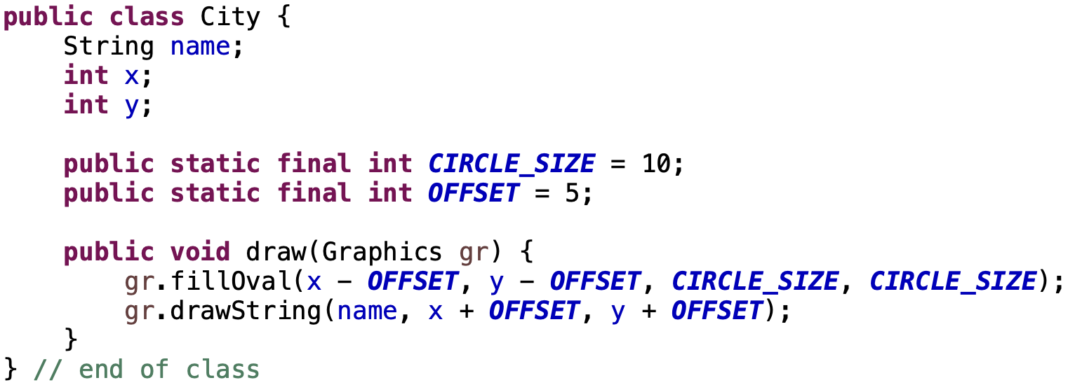
Classes vs. Objects (1)
class: A program entity that represents either:
1. A program / module, or
2. A template for a new type of objects.
By itself, it takes up no memory. If you don’t say new City() in another class, this code will never run. It’s a plan for a thing, but not a thing.

Slide 17
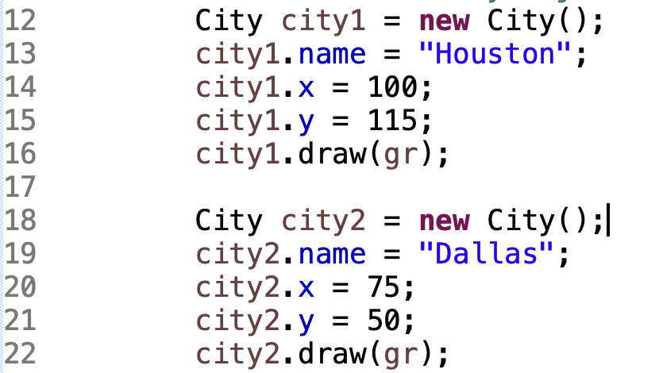
Classes vs. Objects (2)
object: An entity that combines state and behavior, that is in memory during program execution. Based on a class. Can make as many as you like.
city1
name | “Houston”
x | 100
y | 115
city2
name | “Dallas”
x | 75
y | 50

Slide 18
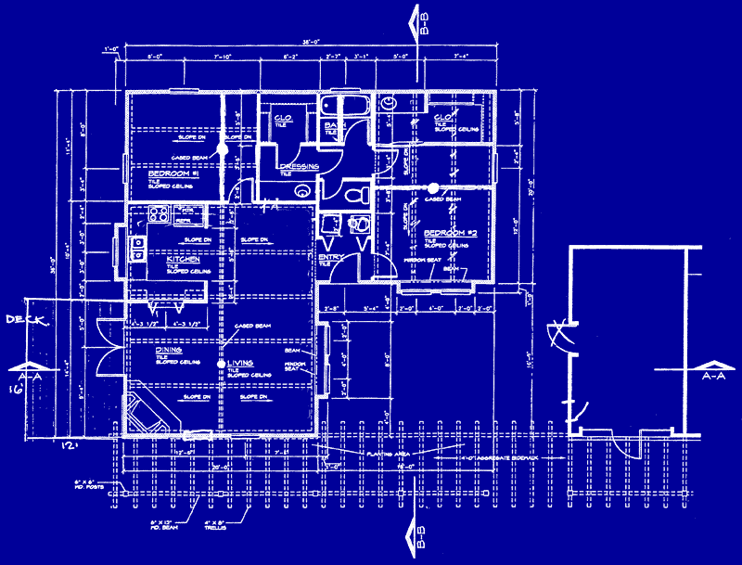
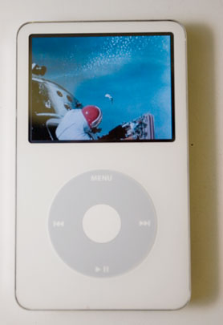
Blueprint Analogy
iPod blueprint
state: current song volume battery life
behavior: power on/off change station/song change volume choose random song
creates
iPod #1
state: song = "1,000,000 Miles" volume = 17 battery life = 2.5 hrs
behavior: power on/off change station/song change volume choose random song
iPod #2
state: song = "Letting You" volume = 9 battery life = 3.41 hrs
behavior: power on/off change station/song change volume choose random song
iPod #3
state: song = "Discipline" volume = 24 battery life = 1.8 hrs
behavior: power on/off change station/song change volume choose random song

Slide 19
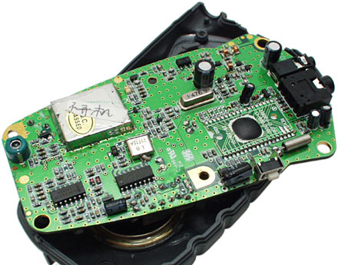
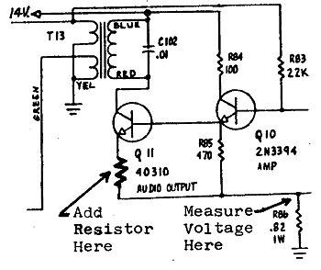
Abstraction
abstraction: A distancing between ideas and details.
We can use objects without knowing how they work.
abstraction in an iPod:
You understand its external behavior (buttons, screen).
You don't understand its inner details, and you don't need to.

Slide 20
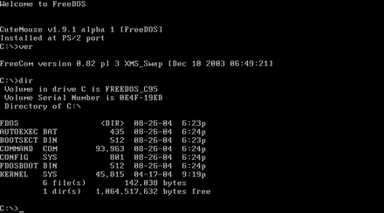
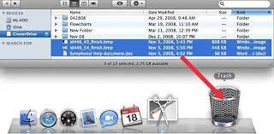
Functional vs. Object-Oriented
verb + noun noun + verb
Photos courtesy of https: wikipedia.com and https://www.google.com/url?sa=i&url=https%3A%2F%2Frecoverit.wondershare.com

Slide 21
Remember
You Belong Here
Hi!

